Slide 1
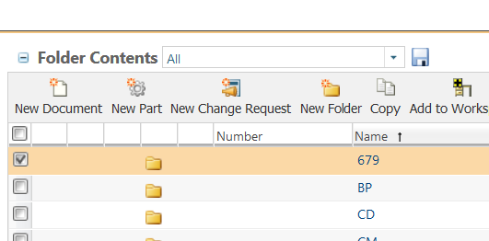


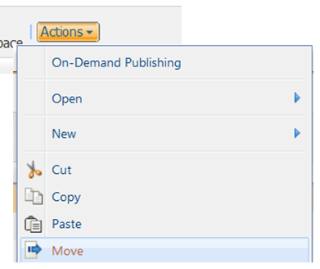

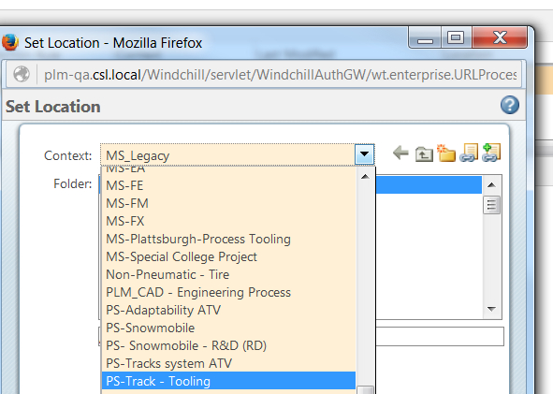
How to Move in Windchill
a. From any Windchill tables. Select What need to be moved by checking the check box.
1 Select
NOTE: - you can select any documents or folders.
a
CAUTION: Read the instructions in sequence. Actions in point 2 should not be done before completing point 1.
b. Click Actions.
c. Select Move
b
Tool Tips
Instead of using the move function you can use the Cut function.
2 Move
c
In the move dialog:
d. Select the context destination.
e. Select Sub Folder (if needed)
3 Destination
If you decided to use the Cut function:
dd. Browse to the destination folder.
ee. Click Actions and paste.
Optionnal
ee

